Slide 1
ECHOCARDIOGRAPHY …From a Sonographer’s Perspective THE NOTEBOOK 8 Chapter I: Normal Cardiac Anatomy & Physiology
Susan King DeWitt, BS, RDCS, RCS

Slide 2
COPYRIGHT INFRINGEMENT IS A SERIOUS CRIME.
Please respect my U.S. Copyright & hard work—do not copy/distribute/edit.
Copyright © 1996, 2002, 2009, 2010, 2011, 2018, 2022. All rights reserved. Library of Congress Catalog Card Numbers: TX0006951179 and TX0008635753.
No part of this publication may be published, shared, edited, voiced over, reproduced, stored in a retrieval system, or transmitted, in any form or by any means, electronic, mechanical, photocopying, recording, or otherwise.
The information in this material is designed to provide education in the field of echocardiography and related topics. It was written, edited, and published by Susan King DeWitt, Author, LLC—a registered cardiac sonographer, not a physician, professional editor, or publishing company. This material does not guarantee a passing grade on the registry exam(s); however, it does discuss most of the test material. References provided do not constitute endorsement of any websites or other sources. Readers should be aware the information and websites listed may change.

Slide 3
ECHO…THE NOTEBOOK 8 & THE WORKBOOK 8
are currently approved by the
Society of Diagnostic Medical Sonography (SDMS)
as a self-instructional activity for
31 CME CREDITS
Please refer to www.echonotebook.com for more details!

Slide 4
I. NORMAL CARDIAC ANATOMY & PHYSIOLOGY
OBJECTIVES
Upon completion of this section, the reader will be able to:
Differentiate the heart vs systemic circulatory system vs pulmonary circulatory system and describe how they work together to perform the vital requirements of the CV system.
Discuss basic adult cardiac anatomy, including the location, pericardium, heart wall, chambers, vessels, and valves.
Identify the cardiac anatomy and normal order of flow through the CV system.
Gain knowledge of the function, location, relation to the cardiac cycle, and normal parameters of the cardiac chambers and valves.
Compare the phases of the cardiac cycle, including IVRT, diastole, IVCT, and systole.
List the components related to cardiac function and CO, methods of altering these components, and a few cardiac equations.
Discuss the basic coronary artery system, venous system, and conduction system.

Slide 5
CARDIAC
ANATOMY

Slide 6
CV SYSTEM
DEFINITION transport blood, gases, nutrients & waste products prevent infection thermoregulation balance fluid THE HEART steady pumping driving force two-sided pump | LEFT HEART receives oxy blood from pulmonary circulatory system pumps to the systemic circulatory system BP hypotension vs HTN
 | RIGHT HEART receives deoxy blood from systemic circulatory system pumps to the pulmonary circulatory system PAP & SPAP PH PCWP
POP QUIZ!
Define HTN & PH.

Slide 7
POP QUIZ!
What do the percentages
represent & where is
blue vs red blood?

Slide 8
POP QUIZ!
Fill in the blanks #1 - 3.
2017 ACC/AHA BP GUIDELINES
BP CATEGORY (at rest) | SYSTOLIC (mmHg) |  | DIASTOLIC (mmHg)
NORMAL BP | (1) | & | < 80 mmHg
ELEVATED BP | 120 - 129 | & | < 80 mmHg
STAGE 1 HTN | 130 - 139 | or | (2)
STAGE 2 HTN | 140 + | or | 90 + mmHg
HTN CRISIS | (3) | &/or | > 120 mmHg
Call a doctor!

Slide 9
POP QUIZ!
Fill in the blanks #1 - 6.
CIRCULATORY SYSTEM | PULMONARY | SYSTEMIC
PRESSURE | (1) | (4)
RESISTANCE | (2) | (5)
O₂ SAT | (3) | (6)

Slide 10
CV SYSTEM
NETWORK OF VESSELS arteries arterioles capillaries venules veins
POP QUIZ!
Trace a drop of blood
(start & finish at the
right atrium).

Slide 11
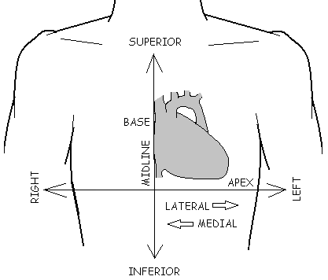
HEART LOCATION
LOCATION thoracic cavity cradled in a cage left of midline above diaphragm BASE superior rotates posterior rightward APEX inferior rotates anterior leftward
POP QUIZ!
Briefly describe the location of the base & the apex.

Slide 12
PERICARDIUM & HEART WALL
PERICARDIUM 1) fibrous pericardium 2) serous pericardium parietal layer (pericardial space & fluid) visceral layer HEART WALL 1) epicardium 2) myocardium 3) endocardium
POP QUIZ!
Identify the layers #1 - 4.
POP QUIZ!
Where does a pericardial effusion accumulate?

Slide 13
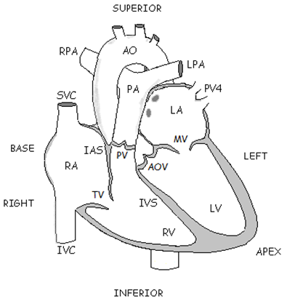
CHAMBERS, VESSELS & VALVES
POP QUIZ!
What is the primary function
of the atria & ventricles?

Slide 14
4 CHAMBERS | 8 GREAT VESSELS | 4 VALVES
2 ATRIA RA & LA RAA & LAA IAS fossa ovalis 2 VENTRICLES RV & LV IVS walls apex | SVC & IVC PA PV4 AO | 2 AV VALVES between atria & ventricles TV & MV diastolic valves components: annulus fibrosus, valvular tissue, chordae tendineae & papillary muscles 2 SL VALVES between ventricles & great arteries PV & AOV systolic valves 3 pocket-like cusps surrounded by annulus similar size significantly smaller than AV valves
POP QUIZ!
What are the great arteries?

Slide 15
VALVES
POP QUIZ!
What type of valve is this?
POP QUIZ!
Identify the valve leaflets & cusps #1 - 11.

Slide 16
POP QUIZ!
Identify the valves #1 - 4.

Slide 17
SVC & IVC
RA, TV, RV
PV, PA, RPA & LPA
PV4 ← LUNGS
AOV, AO, BODY
LA, MV, LV

Slide 18
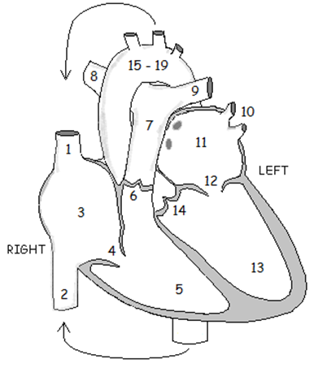
(1) SUPERIOR VENA CAVA (SVC)
(2) INFERIOR VENA CAVA (IVC)
(3) RIGHT ATRIUM (RA)
(4) TRICUSPID VALVE (TV)
(5) RIGHT VENTRICLE (RV)
(6) PULMONIC VALVE (PV)
(7) PULMONARY ARTERY (PA)
(8) RIGHT PULMONARY ARTERY (RPA)
(9) LEFT PULMONARY ARTERY (LPA)
(10) PULMONARY VEINS (PV4)
(11) LEFT ATRIUM (LA)
(12) MITRAL VALVE (MV)
(13) LEFT VENTRICLE (LV)
(14) AORTIC VALVE (AOV)
(15 - 19) AORTA (AO) SEGMENTS

Slide 19

ORDER OF FLOW
(1) SVC receives venous blood from upper body ~ 2 x 7 cm (2) IVC passes along right side of AO in front of spine receives venous blood from lower body diastolic diameter = 1.2 - 2.1 cm
POP QUIZ!
Where exactly do the SVC & IVC drain?

Slide 20

ORDER OF FLOW
(3) RA reservoir for systemic & coronary venous return assists in RV filling RA filling increases with inspiration coronary venous system fossa ovalis eustachian valve Chiari network RAA mean RAP = 2 - 8 mmHg O₂ sat = 75%
POP QUIZ!
What is the O2 sat in the coronary sinus?

Slide 21
CS
left cardiac veins
thebesian valve
great cardiac vein
middle cardiac vein
anterior cardiac veins
right coronary vein
thebesian veins
RA
CORONARY VENOUS SYSTEM

Slide 22
ORDER OF FLOW
(4) TV largest valve & closest to apex between RA & RV 3 leaflets: anterior, medial/septal & posterior chordae tendineae → paps → RV walls compared to MV: TV larger, leaflets thinner, closer to apex, paps more discreet & vary by number/arrangement TVA = 7 - 9 cm² TV velocity = 0.3 - 0.7 m/s
POP QUIZ!
Which valve has the largest area?

Slide 23
ORDER OF FLOW
(5) RV most anterior chamber, beneath sternum & receives deoxy blood from RA RVIT trabeculations moderator band infundibulum/RVOT antero-superior RV wall muscular fold compared to LV: RV walls are thinner; RV chamber is smaller, more triangular & more trabeculated (coarser); moderator band is present RVP = 15 - 25 / 2 - 8 mmHg O₂ sat = 75%
POP QUIZ!
What is another name for the infundibulum?
POP QUIZ!
Compare the RV vs LV trabeculations.

Slide 24
ORDER OF FLOW
(6) PV most superior of all valves between RV & PA 3 pocket-like cusps: anterior, left posterior & right posterior compared to AOV: more superior location & thinner cusps PVA > 2 cm² (similar to AOV) PV velocity = 0.6 - 0.9 m/s
POP QUIZ!
Name 2 valves with the same valve area.

Slide 25
ORDER OF FLOW
(7) PA RV → PV → PA → LPA & RPA PA smaller than AO ~ 5 cm long x < 3 cm (or < aorta diameter) PAP = 15 - 25 / 4 - 12 mmHg (8 & 9) LPA & RPA divide into arteries & arterioles, then pulmonary capillary bed/alveoli PCWP = 2 - 12 mmHg (10) PV4 oxy blood leaves pulmonary capillary bed → venules → PV4 left upper & lower right upper & lower
POP QUIZ!
When is the PA considered enlarged?

Slide 26
ORDER OF FLOW
(11) LA most posterior chamber, reservoir & receives oxy blood from PV4 passageway to LV contractile pump LA filling decreases with inspiration & increases with expiration LAA—normal remnant of embryonic LA long, tubular, hooked appendage within pericardium alongside LV, affected by LVFX decompression chamber increases surface area aids in LA contraction prone to thrombus LAP = 2 - 12 mmHg O₂ sat = 98%
POP QUIZ!
LA walls vs RA walls,
what’s the difference?

Slide 27
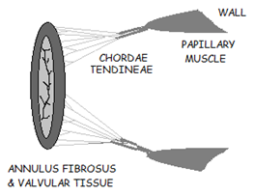
ORDER OF FLOW
(12) MV only valve with 2 leaflets → smiley face 😉 between LA & LV 2 leaflets: PMVL (3 scallops) & AMVL (3 sections) 2 commissures: ant-lat & post-med chordae tendineae 2 papillary muscles: ant-lat & post-med → LV walls MVA = 4 - 6 cm² MV velocity = 0.6 - 1.3 m/s

Slide 28
#1
ORDER OF FLOW
(13) LV most essential/main muscle → numero uno! receives oxy blood from LA thickest walls & largest chamber LVP 5x > RVP inflow tract LVOT LV free wall compared to RV: LV walls are thicker; LV chamber is larger, more conical & less trabeculations (finer); LVP > RVP LVP = < 120 / 3 - 12 mmHg O₂ sat = 98%
POP QUIZ!
Why are the LV walls thicker than the RV walls?

Slide 29
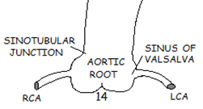
ORDER OF FLOW
(14) AOV most inferior aspect of AO root between LV & AO 3 pocket-like cusps: RCC, LCC & NCC 3 sinuses of Valsalva: anterior/right, left posterior & right posterior coronary artery system (RCA & LCA) nodules of Arantius (x3) Lambl’s excrescences ACS = 1.5 - 2.6 cm AVA > 2 cm² AOV velocity = 1 - 1.7 m/s
POP QUIZ!
What coronary artery is associated with the
right posterior sinus of Valsalva/NCC?

Slide 30
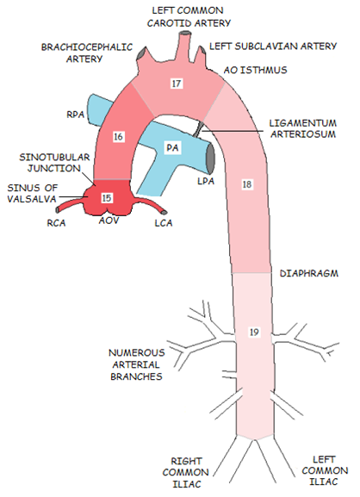
ORDER OF FLOW
(15 – 19) AO LV pumps out to AO → divides → heart , head & body Mother of all arteries! AO pressure < 120 / < 80 mmHg O₂ sat = 98%

Slide 31
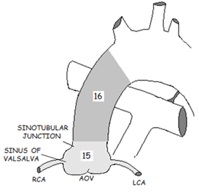
ORDER OF FLOW
(15) AO ROOT & (16) AAO AO root: AOV apparatus → sinotubular junction coronary artery system supply = demand demand > supply → ischemia → infarct Snowflakes! RCA & LCA right vs left vs codominant AAO: just superior to AO root → proximal to AO arch
POP QUIZ!
What percentage of the population has a
right dominant coronary artery system?
POP QUIZ!
Identify the coronary arteries #1 - 6 (assume right dominant).

Slide 32
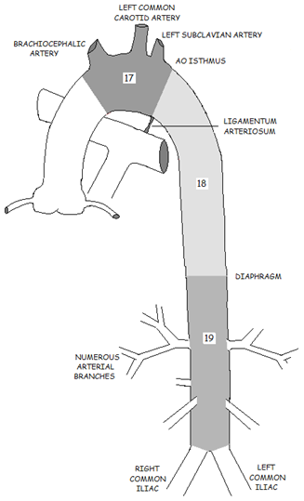
ORDER OF FLOW
(17) AO ARCH 3 branches → divide → head/upper torso → venous system → SVC → RA ligamentum arteriosum AO isthmus (18) THORACIC DAO just after AO arch → level of diaphragm (19) ABDOMINAL DAO from diaphragm → abdomen numerous branches → divide → body → venous system → IVC → RA

Slide 33
POP QUIZ!
Identify the anatomy
in order of flow #1 - 14.

Slide 34
POP QUIZ!
Label the aorta
#15 - 19 & a - e.

Slide 35
POP QUIZ!
Fill in the valve areas #1 - 4.
 | VALVE | AREA (cm²) | VELOCITY (m/s)
AV VALVES | TV | (1) | 0.3 - 0.7
 | MV | (2) | 0.6 - 1.3
SL VALVES | PV | (3) | 0.6 - 0.9
 | AOV | (4) | 1 - 1.7

Slide 36
CARDIAC
PHYSIOLOGY

Slide 37
CARDIAC PHYSIOLOGY
HOW DOES IT WORK? mechanical vs electrical heart’s ability to beat over & over again normal volume & pressure → proper circulation right heart pressure < left heart pressure AV valves—diastolic SL valves—systolic
POP QUIZ!
Briefly describe the difference
between echo & EKG?

Slide 38
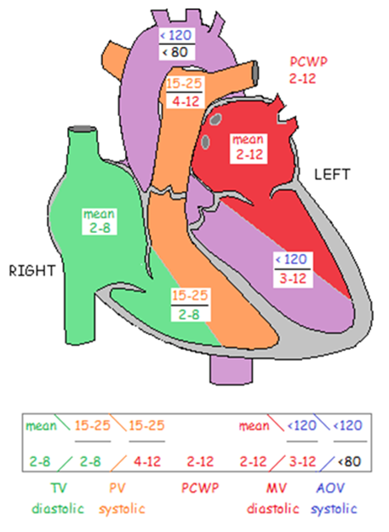
POP QUIZ!
Track the normal pressure similarities through the heart.

Slide 39
POP QUIZ!
Fill in the pressures #1 - 4.
CHAMBER | PRESSURE (mmHg) | O₂ SAT | PRESSURE SIMILARITIES
RA | 2 - 8 (mean) | 75% | mean RAP = RV diastolic pressure
RV | 15 - 25 / (1) | 75% | RV systolic pressure = PA systolic pressure
PA | (2) / 4 - 12 | 75% | PA diastolic pressure = PCWP = mean LAP = LV diastolic pressure
PCWP | 2 - 12
LA | (3) (mean) | 98%
LV | < 120 / 3 - 12 | 98% | LV systolic pressure = AO systolic pressure
AO | (4) / < 80 | 98%

Slide 40
POP QUIZ!
Fill in the blanks #1 - 5.
CYCLE | DEFINITION | AV VALVES | SL VALVES
IVRT | ventricular volumes constant ventricular pressures & wall thickness decrease atrial pressures rise | (1) | (2)
DIASTOLE | period of relaxation & ventricular filling (rapid early filling, diastasis & atrial kick) | (3) | CLOSED
IVCT | ventricular volumes constant ventricular pressures & wall thickness increase | CLOSED | (4)
SYSTOLE | period of contraction & ventricular ejection | (5) | OPEN

Slide 41
POP QUIZ!
Label the cardiac cycle phases A - D.
A B C D

Slide 42
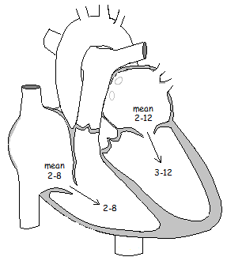
PRESSURE & CARDIAC CYCLE (AV VALVES)
DIASTOLE: AV VALVES OPEN TV & MV open small diastolic PG across open TV & MV mean RAP & RV diastolic pressure between 2 - 8 mmHg mean LAP & LV diastolic pressure between 2 - 12 mmHg rapid early filling diastasis atrial kick ventricular pressures increase & atria complete contraction → TV & MV forced shut (1st heart sound)
POP QUIZ!
When does rapid early filling occur?

Slide 43
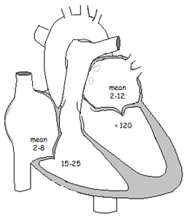
PRESSURE & CARDIAC CYCLE (AV VALVES)
SYSTOLE: AV VALVES CLOSED TV & MV closed noticeable PG across closed TV & MV mean RAP 2 - 8 mmHg RV systolic pressure 15 - 25 mmHg mean LAP 2 - 12 mmHg LV systolic pressure < 120 mmHg this PG plus papillary muscles & chordae tendineae keep valves closed
POP QUIZ
Where is largest normal PG within the heart?

Slide 44
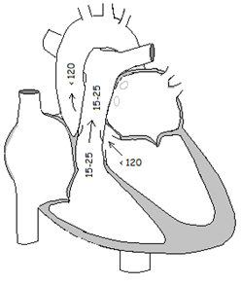
PRESSURE & CARDIAC CYCLE (SL VALVES)
SYSTOLE: SL VALVES OPEN PV & AOV open small systolic PG across open PV & AOV RV systolic pressure & PA systolic pressure between 15 - 25 mmHg LV systolic pressure & AO systolic pressure < 120 mmHg ventricles contract upon receiving blood from the ventricles, great artery pressures rise & ventricular pressures fall → PV & AOV close (2nd heart sound)
POP QUIZ!
Where does ventricular contraction begin?

Slide 45
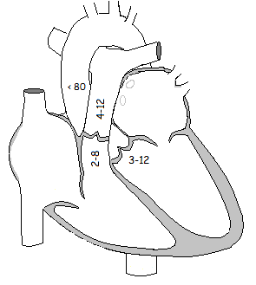
PRESSURE & CARDIAC CYCLE (SL VALVES)
DIASTOLE: SL VALVES CLOSED PV & AOV are closed significant PG across closed PV & AOV RV diastolic pressure 2 - 8 mmHg PA diastolic pressure 4 - 12 mmHg LV diastolic pressure 3 - 12 mmHg AO diastolic pressure < 80 mmHg this PG prevents SL valves from opening
POP QUIZ!
What is the PG across the AOV during diastole?

Slide 46
CARDIAC FUNCTION
HEART’S JOB SUPPLY = DEMAND dependent upon cardiac function
SYSTOLIC FUNCTION ventricles ability to eject blood ? heart disease ? symptoms | DIASTOLIC FUNCTION ventricles ability to relax & fill ? ventricular EDP normal or increased diastolic dysfunction ? heart disease ? symptoms
POP QUIZ!
What determines overall
cardiac function?
POP QUIZ!
Can diastolic dysfunction
precede systolic dysfunction?

Slide 47
CARDIAC FUNCTION
CONTRACTILITY wall thickening & wall motion normal, viable LV walls concentrically thicken & contract ~ 30% → center (systole) equally thin & relax (diastole) if not → global/local IHD → abnormal function/WMA ischemic myocardium → diastolic dysfunction & decreased systolic function (akinesis vs dyskinesis)
CHAMBER SIZE normal, viable chambers concentrically decrease & increase in size | LVEDP & RVEDP correspond to the degree of fiber stretch in the ventricle (aka preload) degree of fiber stretch depends on EDV greater the amount entering the chamber → greater contraction
POP QUIZ!
When do the chambers increase/decrease in size?

Slide 48
(1) no motion
(2) excessive motion
(3) ischemic segment that is akinetic but not infarcted
(4) decreased motion
(5) motion away from center
POP QUIZ!
Match #1 - 5.
AKINESIS
DYSKINESIS
HIBERNATION
HYPERKINESIS
HYPOKINESIS

Slide 49
EQUATIONS
CO = HR x SV (4 – 8 l/min)
SV = EDV – ESV (70 – 100 ml)
CI = CO / BSA (3 – 4 l/min²)
POP QUIZ!
What is CO?

Slide 50
CO depends on cardiac function…
Preload
Afterload
Inotropic force
Chronotropic force

Slide 51
CARDIAC OUTPUT & FUNCTION
PRELOAD EDP EDV Frank-Starling law (length-tension relationship) interval-strength relationship force-velocity relationship results in chamber dilatation | AFTERLOAD resistance heart must pump against higher resistance → greater contractility within heart or circulatory system results in myocardial hypertrophy
INOTROPIC FORCE force of contraction | CHRONOTROPIC FORCE rate of contraction
POP QUIZ!
What increases preload vs afterload?

Slide 52
CARDIAC FUNCTION
PESP post-extrasystolic potentiation ? increased preload due to extra filling time or longer interval ? intracellular calcium handling changes
Why???

Slide 53

POP QUIZ!
How does the
sympathetic
nervous system
affect HR?
CARDIAC FUNCTION
AUTONOMIC NERVOUS SYSTEM responds to metabolic needs of body controls tissues not under voluntary control sympathetic vs parasympathetic
POP QUIZ!
How does the
parasympathetic
nervous system
affect HR?

Slide 54
MANEUVERS
VALSALVA MANEUVER | strain phase—decreases venous return, SV & CO release phase—increases venous return, SV & CO
SQUATTING | increases venous return, SV & CO
STANDING | decreases venous return, SV & CO
AMYL NITRITE INHALATION | decreases peripheral resistance → increases HR, SV & CO
POP QUIZ!
How is the Valsalva maneuver performed during an echo?

Slide 55
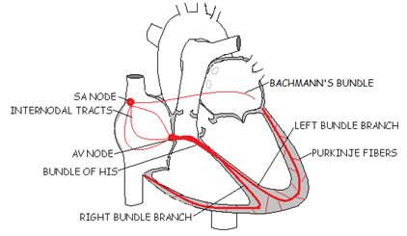
INTRO TO CONDUCTION SYSTEM & EKG
CONDUCTION SYSTEM electrical impulse electrical-mechanical delay atrial systole vs ventricular systole conduction system myocardial cell membrane → depolarization wave → myocardial contraction myocardial cells differ from skeletal muscle (x3)
POP QUIZ!
How are myocardial cells different from skeletal muscle?

Slide 56
CONDUCTION SYSTEM
SA NODE primary pacemaker border of SVC & RA initiates self-generating impulse fuses with atrial muscle fibers produces atrial contraction Bachmann’s bundle if SA node fails, others take over | AV NODE floor of RA receives impulse from SA node via 3 internodal tracts serves as gate to delay electrical conduction SA node & AV node have sympathetic & parasympathetic fibers
POP QUIZ!
What rates do the SA & AV nodes pace?

Slide 57
CONDUCTION SYSTEM
BUNDLE OF HIS within IVS receives impulse from AV node & conducts depolarization wave → apex divides → right & left bundle branches | PURKINJE FIBERS complex network develops from bundle branches spreads → ventricles DEPOLARIZATION & contraction | REPOLARIZATION myocardial relaxation
POP QUIZ!
What direction does depolarization/repolarization travel?

Slide 58
EKG
EKG detects & records heart’s electrical activity
EKG COMPONENTS 1 = PR interval 2 = QRS complex 3 = ST segment 4 = QT interval 5 = T wave 6 = R - R interval
POP QUIZ!
What do the P wave, QRS complex & T wave represent?

Slide 59
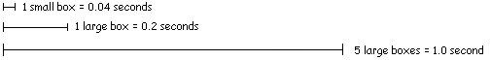
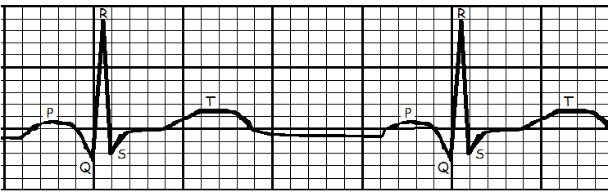
EKG
NORMAL VALUES
R - R interval = 3 to 5 large boxes (60 - 100 bpm)
QRS complex < 3 small boxes (< 0.12 seconds)
PR interval < 1 big box (< 0.2 seconds)
POP QUIZ!
If there is one R wave every
5 large boxes, what is the HR?

Slide 60
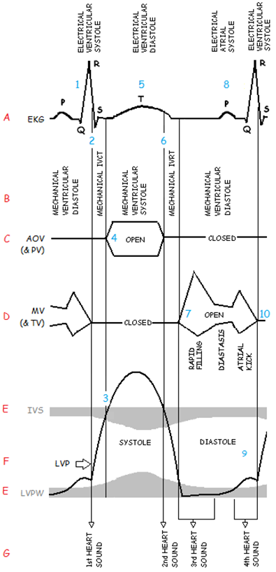
ELECTRICAL & MECHANICAL = CARDIAC CYCLE
Similar to the Wiggers Diagram—represents electrical & mechanical events of the cardiac cycle. [A] electrical cardiac cycle (EKG) [B] mechanical cardiac cycle [C] AOV M-mode (& PV) [D] MV M-mode (& TV) [E] IVS & LVPW M-mode [F] LVP waveform [G] heart sounds | QRS (2) mechanical IVCT (3) IVCT (4) mechanical ventricular systole (5) T wave (6) IVRT (7) mechanical ventricular diastole (8) P wave (9) IVS & LVPW / LVP (10) mechanical ventricular diastole
POP QUIZ!
What is the electrical-mechanical delay?

Slide 61
[A] electrical cardiac cycle (EKG)
[B] mechanical cardiac cycle
[C] AOV & PV
QRS
(2) mechanical IVCT
(4) mechanical ventricular systole
(5) T wave
(6) IVRT
(8) P wave

Slide 62
[D] MV & TV
[E] IVS & LVPW
[F] LVP waveform
[G] 4 heart sounds
(3) IVCT
(7) mechanical ventricular diastole
(9) IVS & LVPW
(10) mechanical ventricular diastole

Slide 63
POP QUIZ!
Identify #1 - 10

